Slide 1

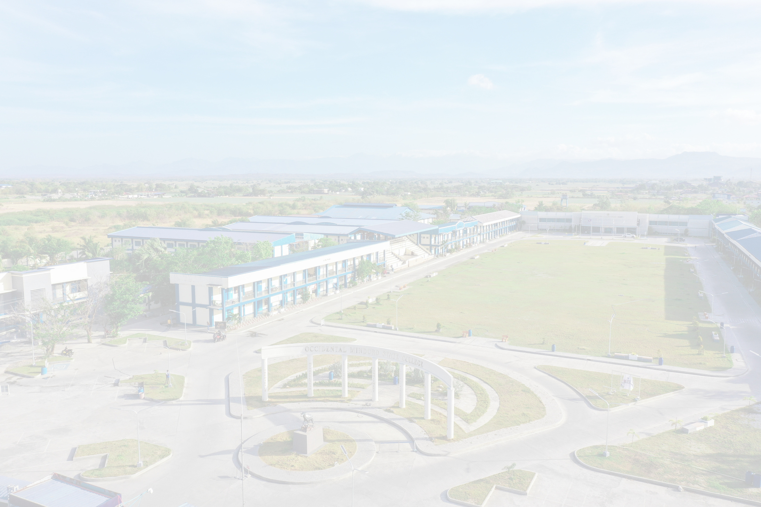
Certificate of Completion
This is presented to :
Rick Andrei E. Arconada
This certificate is awarded for the successful completion of six hundred (600) hours of On-the-Job Training at the Occidental Mindoro State College – Computer Laboratory, Main Campus.
Given this 23rd day of January 2026.
JOVEN T. CRUZ
JOSELITO D. AGUID
Computer Laboratory Custodian
Director for Instruction, CAST

